Slide 1


Strategic Insights for Employee Retention: HR Analytics

Slide 2

Title: Strategic Insights for Employee Retention
Subtitle: Unleashing the Power of HR Analytics
Agenda
Attrition Landscape
Compensation Dynamics
Tailored Retention Strategies
Financial Wellness & Attrition
Longevity Recognition
Work-Life Harmony
Career Progression Impact

Slide 3
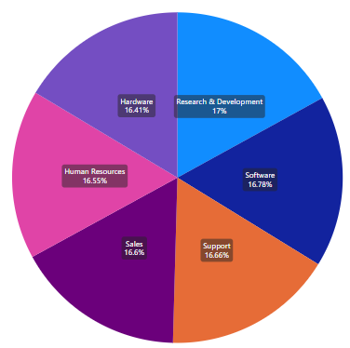
KPI 1
Visual: Engaging pie chart displaying attrition rates by department
Observations
Research & Development faces the highest attrition at 17%
Notable consistency in attrition rates across other departments
Suggestions
Probe deeper into R&D culture and growth opportunities
Consider implementing successful strategies from Hardware and Sales in other departments

Slide 4
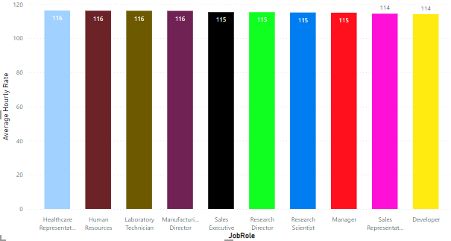
KPI -2
Visual: Captivating bar chart showcasing Average Hourly Rates across job roles
Observations
Healthcare Representatives enjoy the highest hourly rate
Developers experience the lowest
Suggestions
Conduct a comprehensive review of job roles with lower rates
Institute recognition programs for high-earning roles to boost motivation

Slide 5
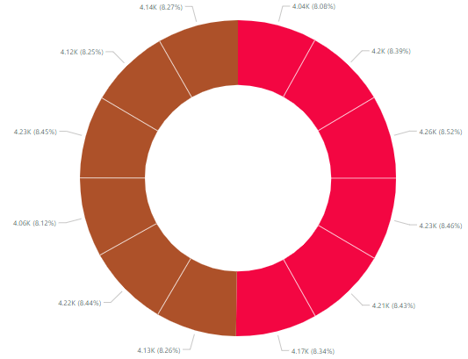
Slide 4: Tailored Retention Strategies
Visual: Insightful doughnut chart illustrating attrition distribution, with a focus on Research & Development
Observations
R&D contributes 8.52% to the overall attrition count
Suggestions
Investigate compensation structures in R&D to address attrition concerns
Ensure a competitive salary framework across all departments

Slide 6
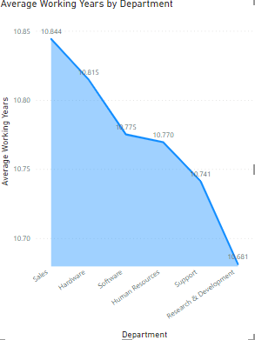
Visual: Dynamic Area chart presenting average working years in each department
Observations
Sales boasts the highest average working years
Slight variation observed across other departments
Suggestions
Institute financial wellness programs for employees in other departments
Recognize and reward long-serving employees in Sales for their loyalty

Slide 7
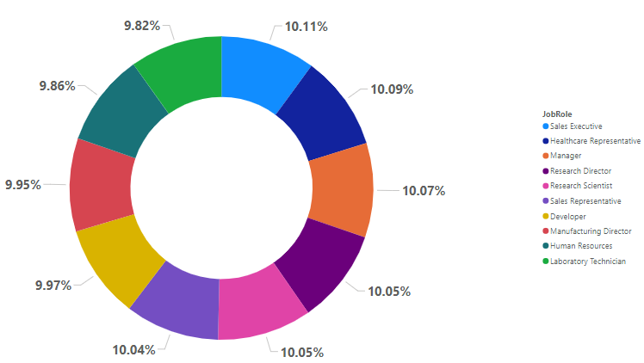
KPI 5
Visual: Engrossing scatter plot correlating work-life balance with working years
Observations
Sales Executives exhibit the highest count of work-life balance
A generally consistent distribution across other job roles
Suggestions
Identify and replicate factors contributing to high work-life balance in Sales
Promote a culture of healthy work-life balance across all job roles

Slide 8
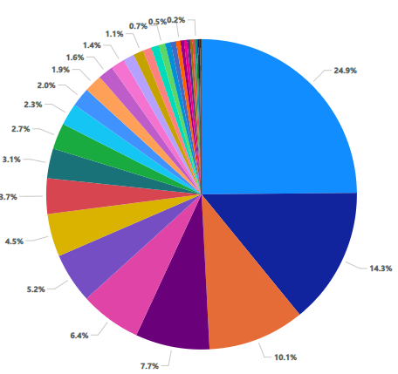
KPI 6
Visual: Compelling bar chart showcasing attrition counts by years since the last promotion
Observations
Higher attrition observed in the early years post-promotion
Lowest attrition noted at 40 years since the last promotion
Suggestions
Implement targeted retention strategies for employees in the early years post-promotion
Recognize and reward employees with longer durations since the last promotion

Slide 9
Conclusion:
Summary: Unveiling strategic insights for enhanced employee retention
Next Steps: Apply tailored strategies to drive positive change
Q&A: Open the floor for discussion and collaboration

